Slide 1
Coffee Chat
with Mrs. Shomaila Faizan
FAST Alumni, CEO of Core Cognitive
and creator of Mina

Slide 2
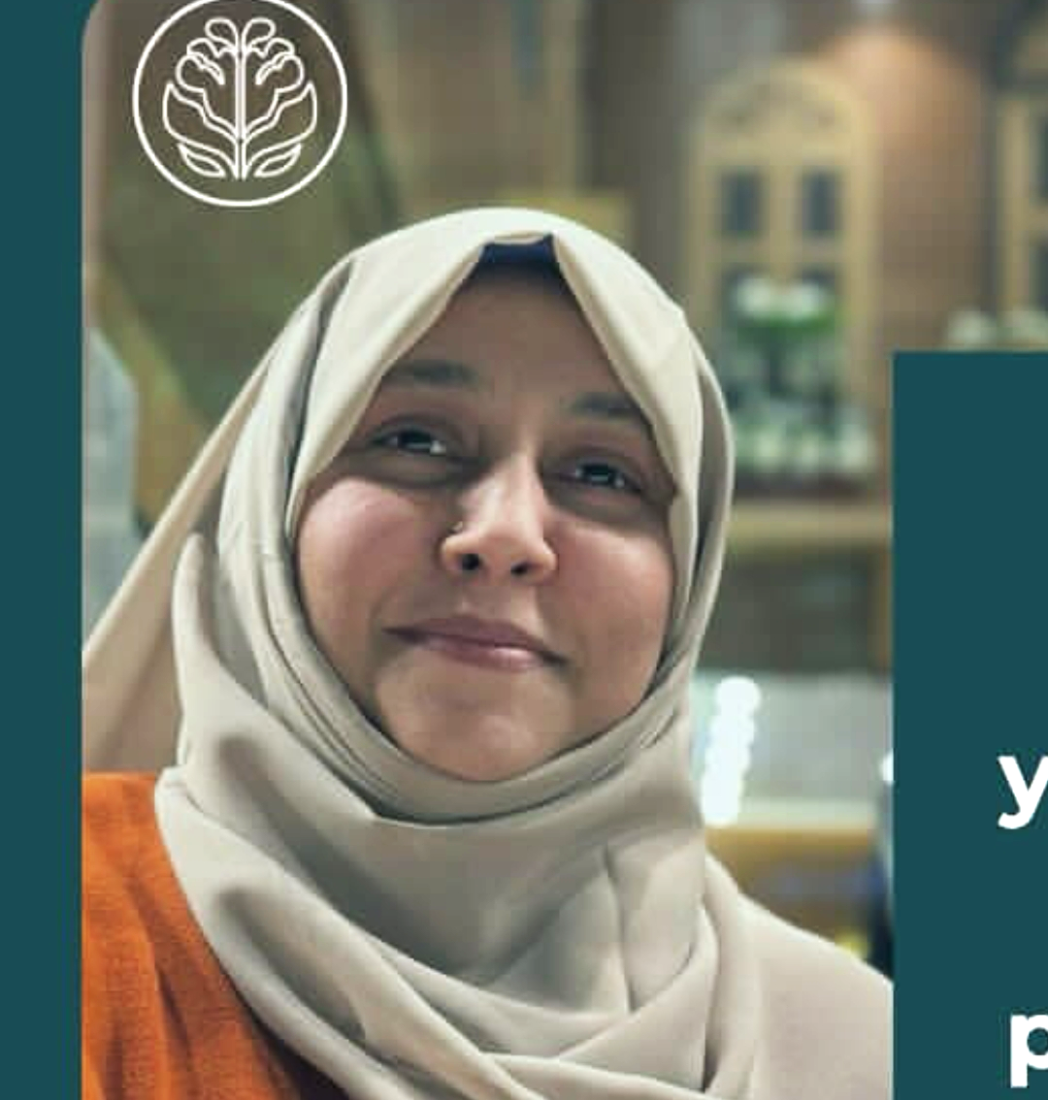
The Professional
FAST-NUCES graduate, BS CS (2001)
Has her own tech startup Corecognitive.io
Works at the intersection of AI, wellness, and coaching

Slide 3
Insights on Culture & Her Role
Work culture: Remote, peer to peer, collaborative
Day-to-day tasks: coaching clients, building AI tools, content creation
“Core Cognitive’s focus was mainly on the learning, reflection, and constant improvement.” - Mrs. Shomaila

Slide 4
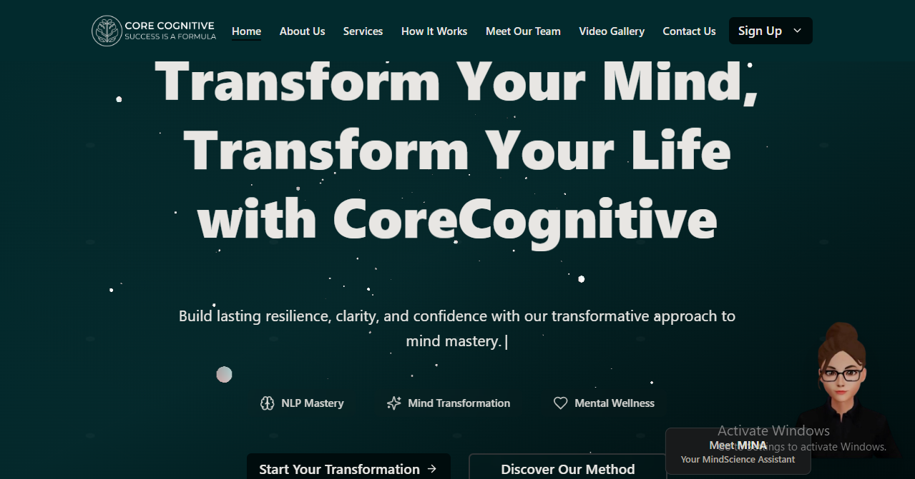
Website: corecognitive.io

Slide 5
Insights on Industry
& Career Path
“We host our website and our Mina AI API on the, you
know, AWS clouds, for now, but um, updating these
systems is always very important”
Technology changes fast — staying updated is necessary
Continuous learning helps you stay relevant in the CS industry
New tools like AI, Machine Learning, and automation are shaping future careers

Slide 6
Popular Advice Mrs. Shomaila does not believe in personally:
Personal Advice for First-Year Students:
“This hustle culture which is very popular… doesn’t always lead to the best case scenario, it, rather, causes very big burnouts.”
Use time effectively, give yourself time to rest and reflect
Using strategies like Pomodoro gives better results than cramming.
“You’re Generation Z right? So your generation has a very, short temper, and low patience so I think building that up is, very important, yes”
Engage in tasks for the sake of learning
Learn to enjoy the process instead of just waiting for the result

Slide 7
Conclusion
“CS is not only about the coding. It’s about, you know, creativity, learning, and building the meaningful solutions from the problems you are given”
Mrs. Shomaila

Slide 8
Thank You for Listening!
John Doe - 25I-0xxx
Jane Doe - 25I-0xxx
Please keep this slide for attribution

